Slide 1
Basics of MATLAB GUIs
Honors ENGI 1331
Spring 2019

Slide 2
A Gentle Introduction to App Designer
MATLAB App Designer is a GUI-building environment that comes prepackaged with MATLAB. You do not need to install any add-ons to use App Designer. To open App Designer, simply type “appdesigner” in the command window
You will be using MATLAB App Designer to create an application that allows a user to communicate with an Arduino to interact with a “game board”
App Designer Introduction
App Designer Examples

Slide 3
What is a GUI?
A Graphical User Interface (GUI) allows a user to interact with a program. GUIs often have graphical icons and visual indicators, as opposed to text-based user interfaces. GUIs were created as a response to the steep learning curve of the command line interface.
You will be creating a GUI using MATLAB’s App Designer tool. This GUI will allow a user to communicate with an Arduino using MATLAB, even if that user has no idea what MATLAB is or how to use it.

Slide 4
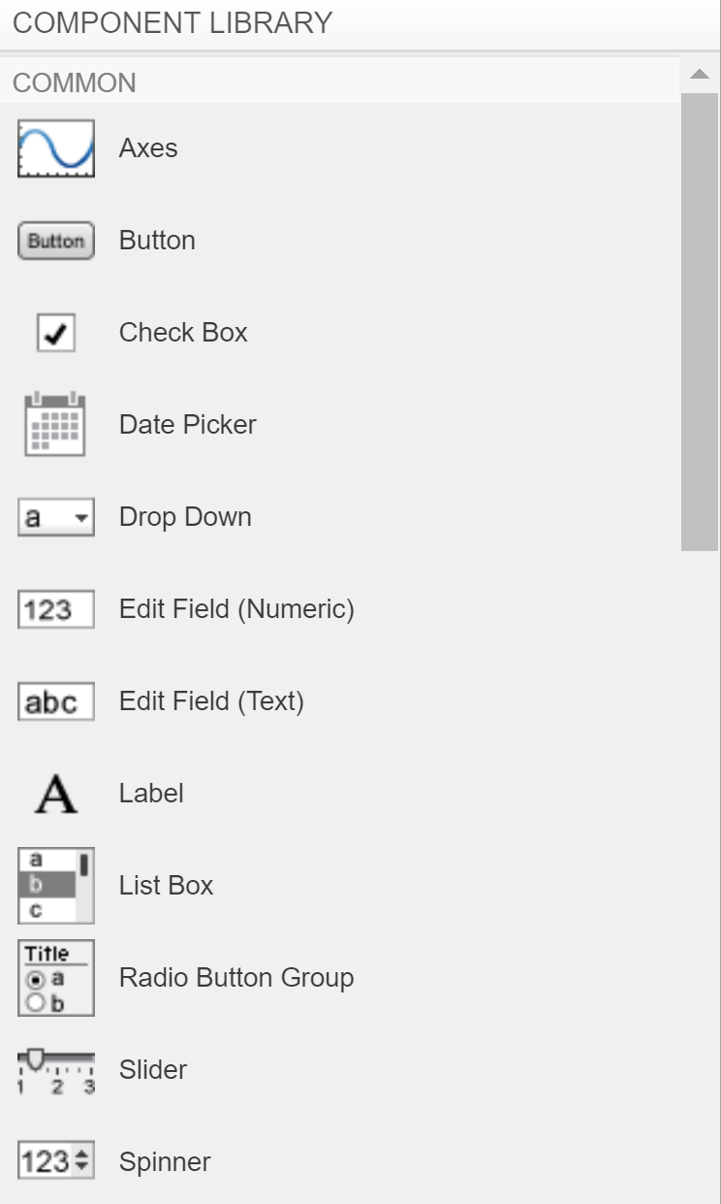
Components
GUIs are built on interactive components. Usually there are several clickable components which all have different purposes (the x button on the top right of your browser is different than the _ button)
App Designer makes it easy to add components to your GUI. Upon opening App Designer, you will see a blank canvas with a component library on the left. Click and drag a component to the canvas to insert it into your GUI. Each component has a different intended purpose, but they do not do anything yet.
Commonly used components

Slide 5
Callback Function
The code the GUI executes after the user interacts with a component is called a callback function. Each component in the GUI has its own unique callback function, which you can view by clicking on the ‘code view’ tab above the canvas.
The code is already organized and segmented for you, your job is to write code that does what you want it to do. Most of the GUI code is pre-generated by MATLAB and is not editable.

Slide 6
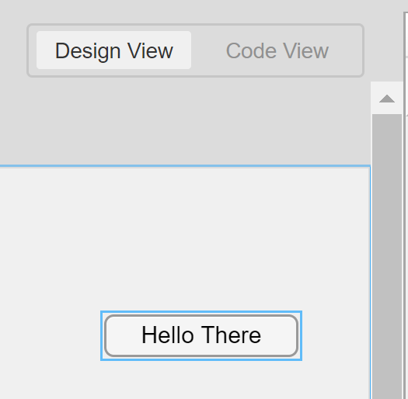
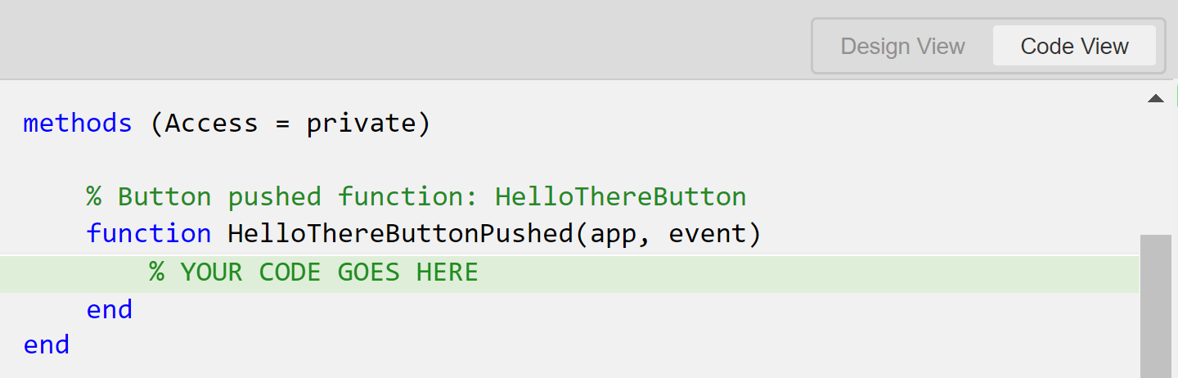
Callback Function example
Note that the Hello There button has a callback function called HelloThereButtonPushed. MATLAB will automatically generate this name and you cannot change it. All lines in grey are not editable.

Slide 7
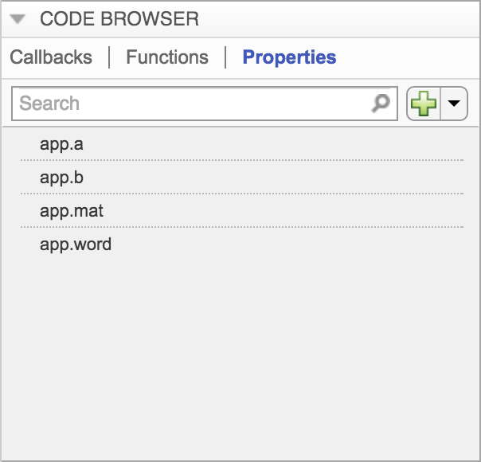
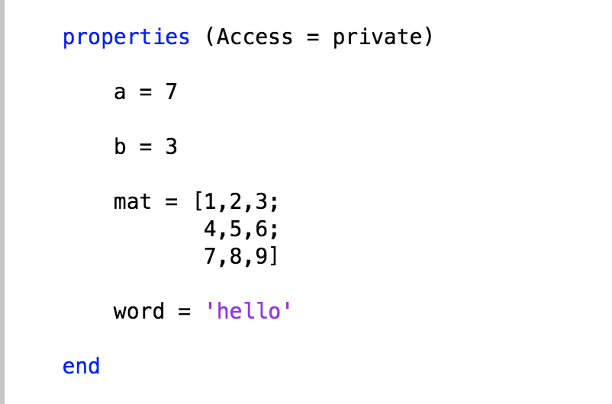
Properties
Properties are like global variables, pieces of data stored within the app (things like matrices, numerical values, strings, etc). Properties are the variables of an app. Properties will appear under the ‘properties’ section of your code. You can create/delete properties by using the code browser or by directly editing the code.

Slide 8
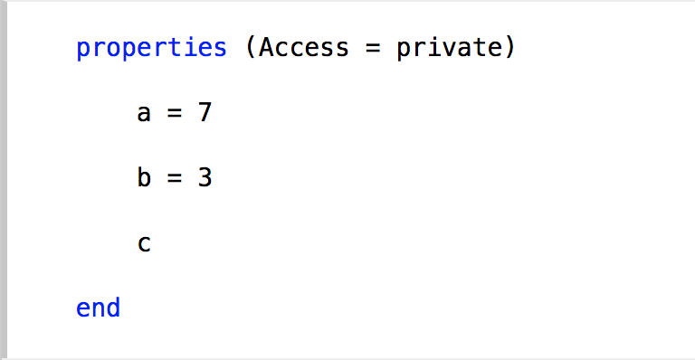

Properties (Cont.)
You can only create properties by listing them under the Properties section of your code. You CANNOT define a new property in one of your functions.
When creating properties, you don’t have to give them a value. In this project you will be using a property to refer to your arduino object. We recommend initializing this property to the arduino using the arduino() function when you create it.
When referencing a property in one of your functions, “app.” has to be added before the name.
c will now be equal to 10

Slide 9
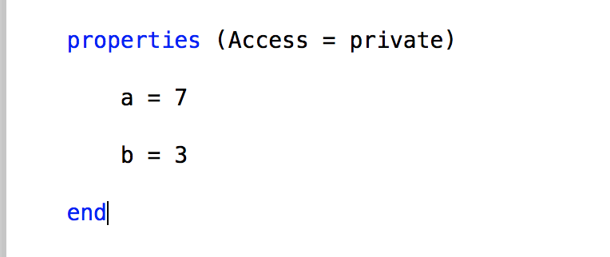
Properties Example
The code below would not work. (c was not defined in the properties section before it was referenced)

Slide 10
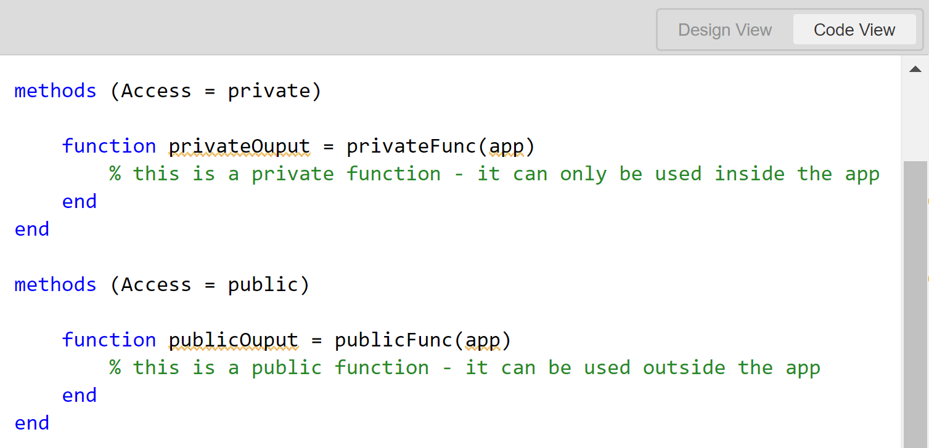
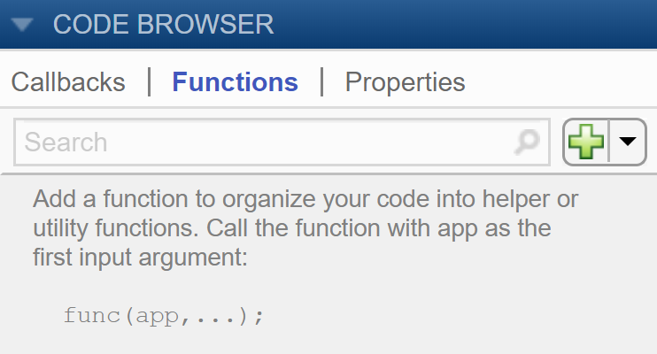
User-Defined Functions
User-defined functions are made in the methods section of the code. These functions can be either public or private, but this is not important for this project. You may define your functions as either private or public, but this should not affect functionality.

Slide 11
Using Arduinos in MATLAB
Honors ENGI 1331
Spring 2019

Slide 12
Adding the Arduino
In this project we will be making multiple circuits on a breadboard. We need a device that can communicate with MATLAB and send the corresponding signals to the elements in these circuits. For this project, the device we will be using is an Arduino Uno.
To use the Arduino Uno with MATLAB, you will need to install an add-on that gives you the ability to control the Arduino with MATLAB code. We will be using the Simulink Support Package for Arduino Hardware.
Click here to go to the download page

Slide 13
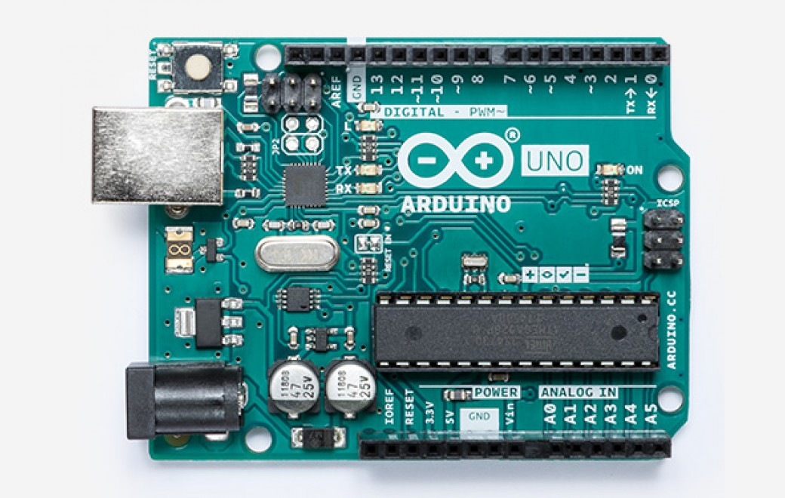
I/O (input and output)
USB Connector/Power Supply
Digital Pins (the pins you want to use)
An Arduino is a microcontroller. A microcontroller is a device that contains a processor, memory, and pins that can both send and receive signals.
There are two types of pins, analog and digital. Digital pins only output 2 values: 1s and 0s. Analog pins can output 256 values, from 0 to 255. In this project, you will only be using the digital pins.
Analog Pins

Slide 14
I/O (continued)
The MATLAB support package for Arduino hardware comes with many built-in functions that allow you to communicate with your Arduino.
arduino() creates an arduino object. Typically we write ard = arduino() to assign the arduino object to the variable “ard”. An arduino object contains information about your Arduino Uno and allows MATLAB to communicate with it.
writeDigitialPin(ard, pin, value) takes in an arduino ard, a pin number pin such as “D12” that specifies the pin we are communicating with, and a value of 1 or 0, which means “on” and “off”, respectively.

Slide 15
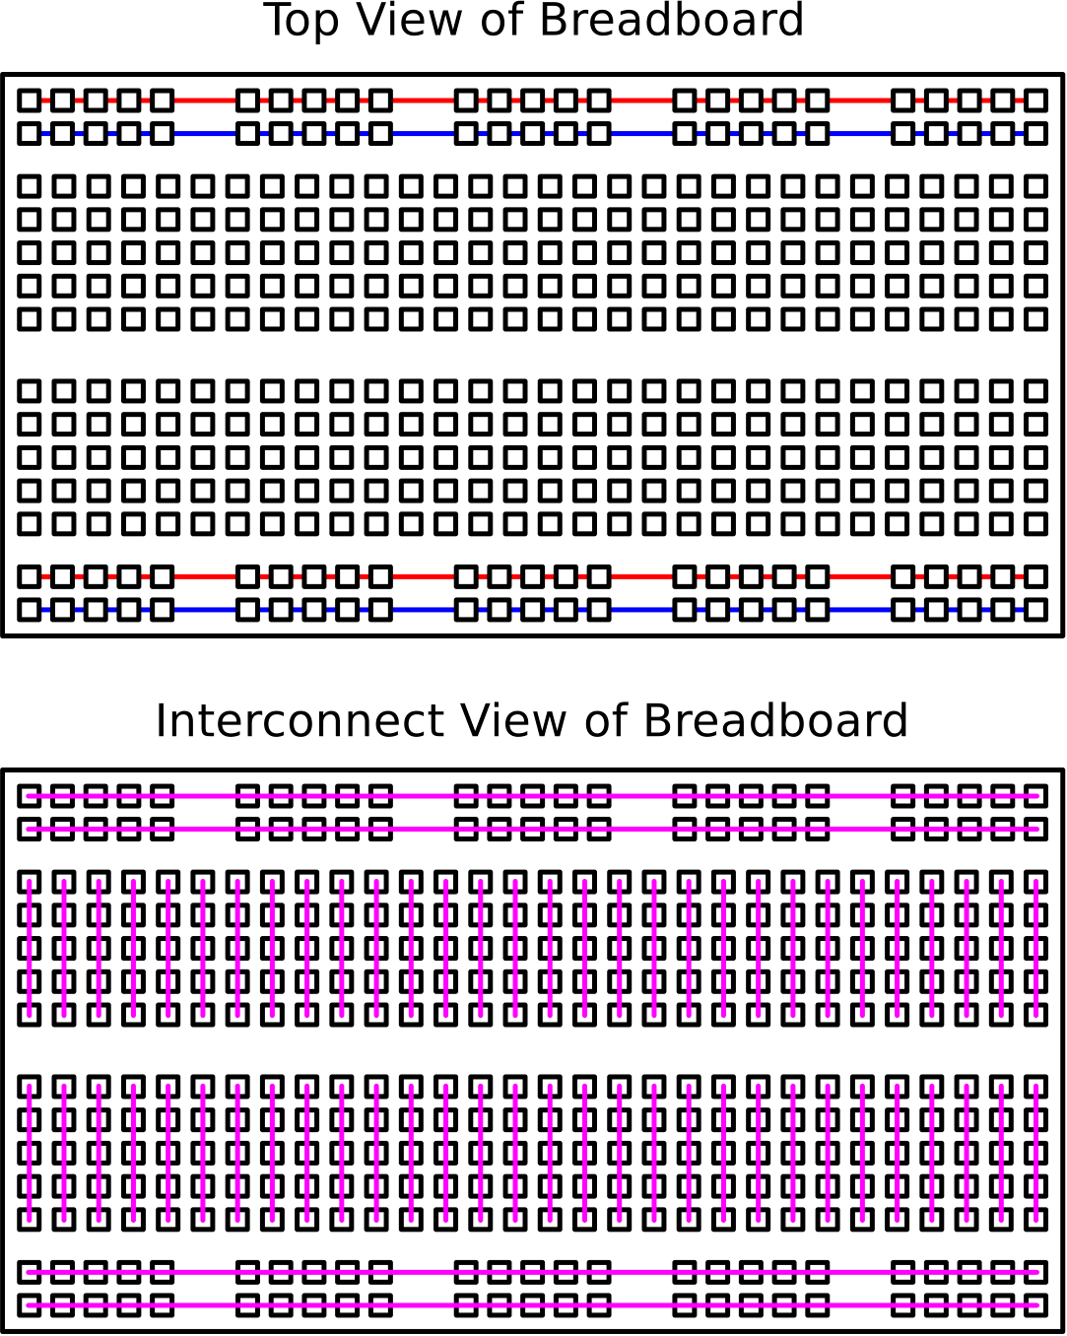
Breadboards and Circuits
In this project, you will be wiring LEDs to your Arduino using a breadboard. Breadboards provide an easy way to make circuits without soldering.
Your circuit in this project will consist of an LED in series with a resistor, connected to the Arduino (series means the current through the resistor and the LED is the same).
The diagram on the left shows how the holes on the breadboard are connected to each other. If the holes are connected by a straight red line, they are in series with each other.

Slide 16
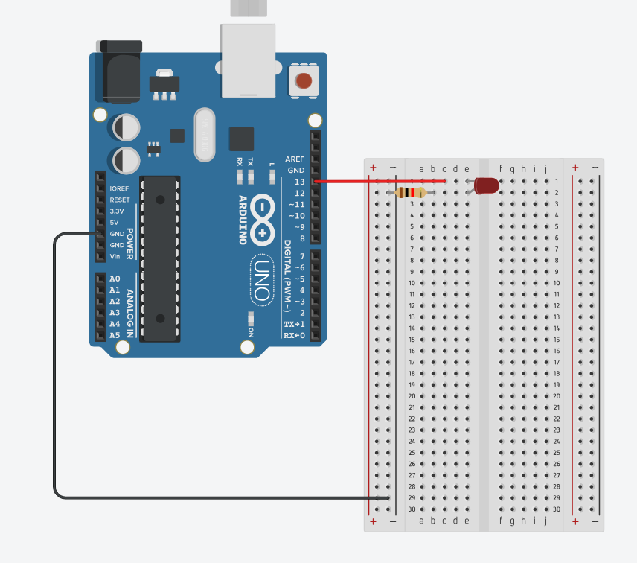
Breadboards and Circuits (Cont.)
The picture on the right shows a single circuit containing an LED in series with a 1kΩ resistor. Over the next few slides, we will detail how the components in this circuit are connected to one another.
The LED draws power from pin D13 on the Arduino, which it can do because they are connected by a red wire. The wire goes from pin D13 to C1 on the breadboard.

Slide 17
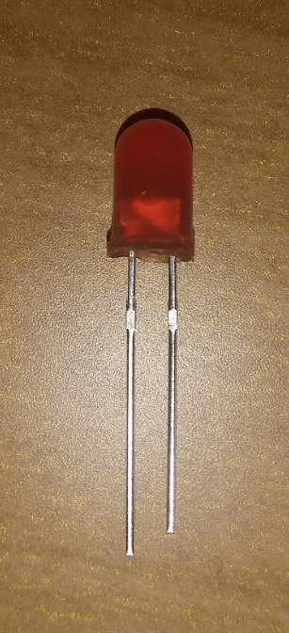
A Brief Tangent About LEDs
It is important to note that current can only travel one way through an LED. LED stands for light emitting diode, and a diode is a component that blocks all current flowing in a certain direction.
You can tell what direction of current the LED allows by looking at the length of the two wires connected to it. The longer wire is known as the cathode, and the shorter wire is known as the anode. By convention, current travels from cathode to anode, so you need to make sure the longer side of the LED is connected to the power source.

Slide 18
Breadboards and Circuits (Cont.)
Since each horizontal row on the breadboard is connected in series, the entire first row of the breadboard can be thought of as directly connected to the Arduino. Because of this, we can put the cathode end of the LED anywhere on the first row.
In our diagram, we put the cathode in hole E1, but you can place the cathode end on any other hole in that same row.

Slide 19
Breadboards and Circuits (Cont.)
After connecting the LED cathode to hole E1, we connect the LED anode to hole E2 (the same hole one row down). Again, that entire row can be thought of as directly connected to the anode of the LED.
We want to connect a resistor to the LED, so we need to place one end of the resistor on the second row. We attach the resistor to hole A2 and attach the other end to the left side of the breadboard.

Slide 20
Breadboards and Circuits (Cont.)
The sides of the breadboards are connected vertically and are known as bus strips. They are labeled as + and -, one for input voltage and the other for ground. Bus strips exist so you can easily connect a circuit to an electrical ground.
All circuits must form closed loops. A closed loop in our case means that if the circuit begins at the Arduino, it should end at the Arduino.

Slide 21
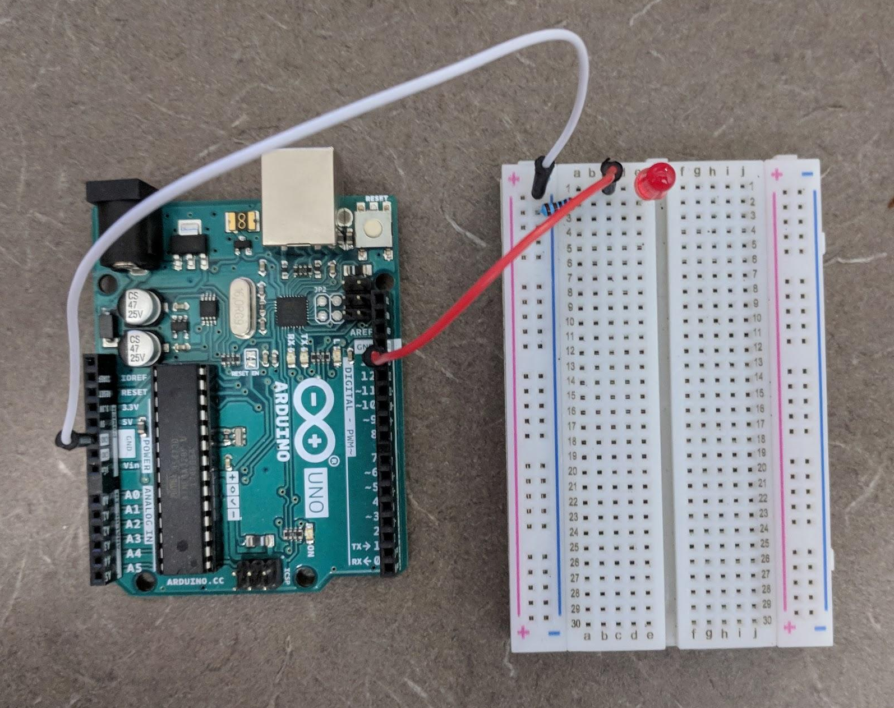
Breadboards and Circuits (Cont.)
The resistor connects the second row to a bus strip on the left side of the breadboard. That bus strip is attached to the Arduino by a white cable that goes from the bus strip to one of three ground pins on the Arduino.
The reason we connect each circuit to the bus strip instead of directly to the Arduino is because we will be making more than three LED circuits, but we only have three ground pins. It is simpler to connect each circuit to a bus strip and connect the bus strip to ground.

